Slide 1
Bellwork
Get out your chart from Wednesday
With a partner, work to complete as much of the chart as possible
We will begin our notes in 5 minutes

Slide 2
Biomes Notes
Desert
Forest
Very little rainfall
Very few plants
Conserve water
“Hot” and “Cold” deserts
Both cold at night
Few large animals
Most are small, nocturnal, & burrow
Moderate to high rain
Lots of plants
3 main kinds
Temperate, Boreal, Rainforest
Many types of different animals
Tropical rainforest has highest biodiversity in world

Slide 3
Biomes Notes
Tundra
Grassland
Cold
Ground has unfrozen layer, “permafrost”
Small plants
Moss, scrub
Some animal life
Few larger, like deer
Many smaller
Many different climates
Some rain
Not enough to allow major tree growth
Many plants and animals
Antelope, oxen, zebra, etc.

Slide 4
Theory
Theory: statement(s) that explain something, accepted as fact and backed by evidence
Theories are based on scientific evidence
New evidence can adjust the theory
Just because something is a theory does not mean it is not true!
An idea based on a hunch or feelings is not a theory!
This is a definition of faith
The ideas presented in these notes are a reflection of scientific theory, and will be treated as such
If faith disagrees with these theories, that is an issue to be dealt with outside of the classroom (it’s a legal thing)

Slide 5
Homo Sapiens Sapiens
A hominid is a scientific family of primates that includes humans and our closest relatives
Domain-Kingdom-Phylum-Class-Order-Family-Genus-Species
Hominidae includes humans, chimpanzees, gorillas, and other great apes
Modern humans are homo sapiens sapiens
Homo = same Sapient = thinking
Thus, homo sapiens sapiens is the thing that really thinks like us
Humans appear in fossils about 200,000 yrs ago
Earlier hominids have different scientific names…

Slide 6
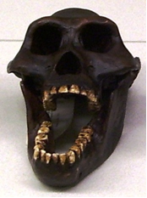
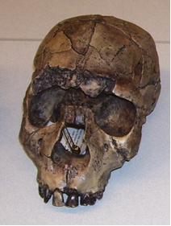
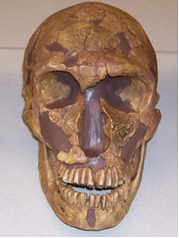
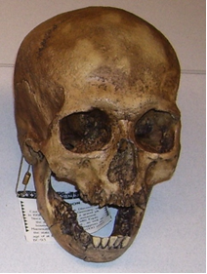
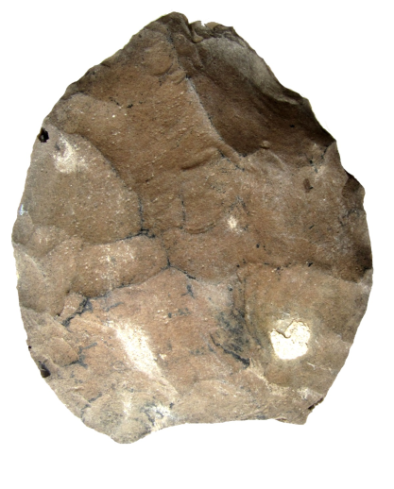
Early Hominids
The theory of human evolution states that modern humans evolved from earlier hominids
Not all hominids were or are directly involved in the human evolutionary chain
Oldest known member of homo genus is homo habilis
Used stone tools, fossils found in Africa, ~2.3 mil yrs ago
Homo erectus first moved out of Africa
Name refers to constant upright walking, roughly around 1.8 to 150,000 yrs ago, first use of the “hand axe”
Homo neanderthalensis was our closest relative
Shared about 99.7% of dna (Still a big difference though)
Classic “caveman” look modeled after Neanderthals
Fossils in Europe, Middle East, and Central Asia

Slide 7
Bellwork
Sit in your assigned seat
Get out your note sheet from Friday
With your table, review the notes you have
Up to homo neanderthalensis
Make sure you have something to write with for today’s notes.

Slide 8
Why Africa?
Earliest hominid fossils all found in the Great Rift Valley
In East Africa, modern day Ethiopia, Somalia
This area had both forest and grassland biomes
Earliest ancestors lived in forests for protection
Other animals ate hominids regularly
Newer ancestors ventured farther and farther from the forested areas
Possibly protected with tools, hips also evolved to run faster
Ancestors evolved thinking capabilities
Hence, bigger skulls to hold bigger brains
Walking upright to carry big ol’ heads

Slide 9
Early Humans
After ancestors (or maybe even early humans!) moved out of Africa, they spread
Homo sapiens spread to every continent more than 5000 years ago
But…why?
Early humans were foragers
They moved from place to place finding food
Mostly nuts, berries, fruits, but also sometimes hunting
Any given place can only hold so many people
Called carrying capacity
As population grew, people had to go elsewhere to eat
Learned to follow the most useful animals
Woolly mammoth best example

Slide 10
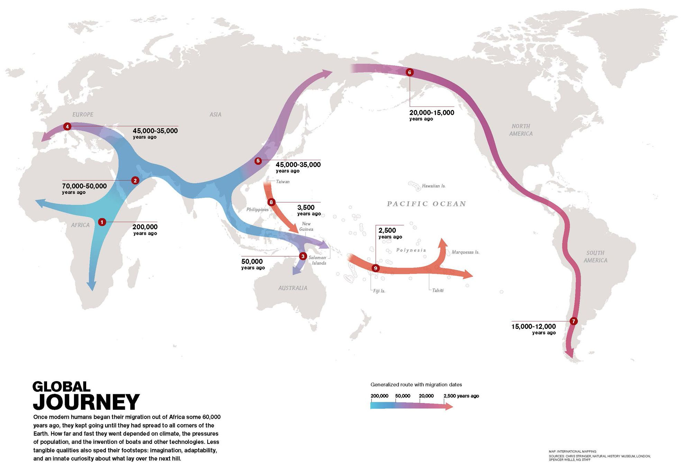

Slide 11
The “end” of foraging
Humans foraged for more than 150,000 years of existence
Most efficient way to get food
Around 10,000 years ago, some people started settling down
Mostly near rivers
In areas with plants and animals that could be domesticated
Domestication: the act of turning a wild species into a species that can be raised by people for food
Not everyone stopped
Even today, foraging cultures still exist

Slide 12
Why settle?
Safer
Areas settled had natural defenses, like mountains and rivers
Large population
End of the Ice Age thawed out and population grew faster than food supplies as mammoths disappeared, meaning humans needed more food
Luck?
No one is sure how domestication started, and some of it was likely coincidence—the right place at the right time
“Peer” pressure
Some groups settled sooner, and may have presented a threat to groups that did not
4000-5000 years between earliest farmers and first major civilizations, so it wasn’t overnight.

