Slide 1
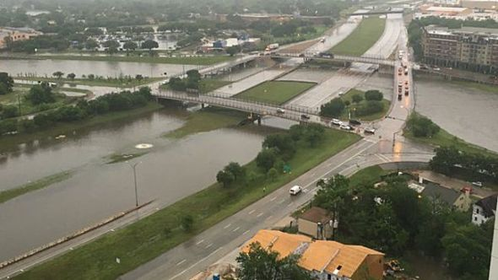
Bellwork
With your East-West partner, discuss what you think this is a photo of (you don’t need to write today’s bellwork)
Be prepared to share your thoughts with the class

Slide 2
Today’s class
Write down each of the bullet points on each slide
Some will be review
If you have questions, raise your hand to ask!
This information is very important in order for us to have a successful year, so be focused
It might not be the most interesting, but staying focused even when things don’t grab your attention is an important life and work skill

Slide 3
Daily Procedures
Entering Class
Quietly come into the classroom
Get your folder from the class bin and take sit in your assigned seat
Begin work on the daily bellwork posted on the board
When bellwork is finished, read over the daily learning target and be prepared to discuss it
Sit quietly and wait for the teacher to begin the lesson when you are finished
If you are tardy, bring your office slip to the teacher and then silently take your seat
Materials and Supplies
If you need any materials or supplies that are not in your table’s supply bin, raise your hand with a “peace sign”
When given the signal (pointed at and thumbs-up from the teacher), quietly go get the supplies you need, then return to your seat
If the supply is a communal tool (tape, stapler, globe, etc), raise your hand in a “peace” sign and wait for the signal to return it, then quietly take your seat

Slide 4
Daily Procedures (2)
Teacher’s Desk
Only approach the teacher’s desk when invited to
Materials on the teacher’s desk are to remain on the desk at all times
Turning in work
Class work will be collected daily at the end of class
Ensure your name and hour are on your work
Work will be turned in to the teacher before you leave class
Passed Back work
Papers to be passed back are located in the class bin
You may collect your own papers from the class bin by raising your hand and asking permission when your class work is completed
You may ask permission to pass back others’ papers only if your work is completed and it is a silent seatwork activity

Slide 5
Daily Procedures (3)
Hall Passes
If you need to use a hall pass, raise your hand and the teacher will come to you at an appropriate time
You will only be allowed 5 hall passes per trimester
Hall passes will not be given any day a substitute is in the room
Ending Class
With about 5 minutes before class ends, you will be instructed to start cleaning up
Turn in your class work to the teacher
Make sure your area is clean, with nothing left on the floor
Check to see if other class areas need to be picked up, and then assist in cleaning those areas
Once the room is clean, silently take your seat and wait to be dismissed by the teacher
Walk calmly and quietly to your locker and your next class

Slide 6
Task-Specific Procedures
Individual Seatwork
Noise level: 0—No talking
If you need help, raise your hand
Seatwork will often be timed, and a timer will be posted on the board
Stay seated unless given permission to move (raise hand or give “peace” sign for materials)
Show you are focused by working on the given task following the written and verbal instructions
Small-group Work
Noise level: 1—Quiet voice
If you need help, discuss as a group, then raise your hand
Group work may be timed, check the board for a timer if instructions mentioned a time
Stay seated with your group unless given permission to move
Show you are focused by completing your task within the group so the group can succeed at meeting the given instructions (instructions may differ from group to group)

Slide 7
Task-Specific Procedures (2)
Whole-class
Noise level—0: no talking when not your turn, 2—normal voice when you are given permission to speak so the whole class can hear you
Raise your hand to contribute to the discussion or ask questions
Make sure you are completing the given work (notes, worksheet, questions) or are adding to the conversation with your ideas (class-discussion)
Stay seated unless instructed to move as part of the activity, no other permission will be given to move
Tests/Quizzes
Noise level—0: no talking
If you need help, raise your hand
Tests are given the whole class period to be completed, quizzes may be timed
Stay seated, no permission will be given to move
Show you are focused by completing the test or quiz doing the best job you can

Slide 8
Task-Specific Procedures (3)
Fire Drill
Line up quietly at the door, last person out turn off the lights and close the door
Walk calmly and quietly out through the hall out the end of the hallway exit
Calmly walk to the grass past the parking lot, and line up behind the stones
Quietly listen for instructions/attendance from the teacher
Tornado Drill
Quietly line up at the inter-class door
Join the neighboring class along the wall in the safety position
Stay quiet and listen for additional instructions
Lockdown
Remain quiet and calm
In low-level lockdown, door will be closed and we continue working
High lockdown, door closed and shades down, lights off, and silently hide away from windows

