Slide 1
Bellwork
What challenges do historians face in using maps created in the present time to study the past?
What challenges do historians face in using old maps to study the past?
Save your answers to review later

Slide 2
Continents
Continent: an expanse or mass of continuous land
Assignment instructions: Label the continents on the map, then answer the questions.
  You will have 5 minutes

Slide 3
Continents
Is Europe a continent?
  Is Europe continuous (from ocean to ocean)?
  Is there another way to organize Europe into a different continent?
  Why do people say it is a continent?
Continents are defined by people, meaning what is-and isn’t-a continent is a statement of power (political, social, economic, etc)

Slide 4
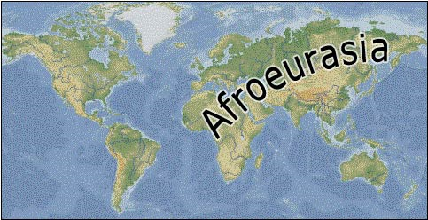
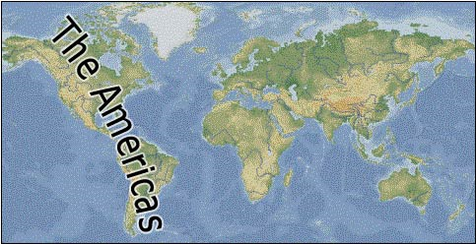
Continents+

Slide 5
Afroeurasian Trades Routes in the 14th Century.
1. Compare the two maps and the patterns of movement shown on each. What do you notice?
Route of the Bubonic Plague, also called the Black Death, a disease that resulted in the deaths of up to ½ of Europe’s population in the 14th century.

Slide 6
Afroeurasian Trades Routes in the 14th Century.
2. Looking at the two maps together, how do you think the Black Death spread?
Route of the Bubonic Plague, also called the Black Death, a disease that resulted in the deaths of up to ½ of Europe’s population in the 14th century.

Slide 7
Afroeurasian Trades Routes in the 14th Century.
3. Looking at the maps, where might the Black Death have started?
Route of the Bubonic Plague, also called the Black Death, a disease that resulted in the deaths of up to ½ of Europe’s population in the 14th century.

Slide 8
Afroeurasian Trades Routes in the 14th Century.
4. What might be one consequence of increased trade and increased human interactions?
Route of the Bubonic Plague, also called the Black Death, a disease that resulted in the deaths of up to ½ of Europe’s population in the 14th century.

Slide 9
Instructions
Review the 3 maps on the sheet
Use the maps to help you answer the questions on the back of the sheet
  This is due at the end of the hour

